Slide 1
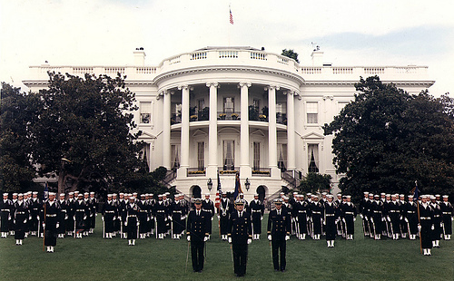
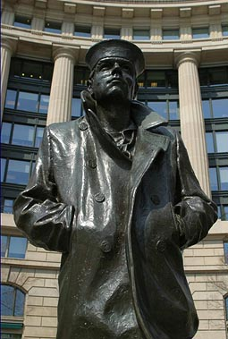
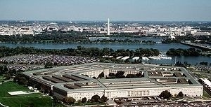
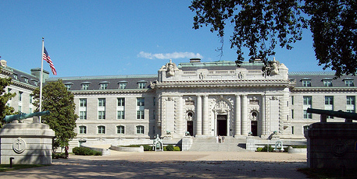
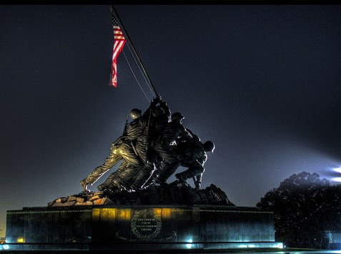
Fleet Logistics Supply Center
Norfolk NDW POSTAL DIVISION
Mail Security Brief
WHAT YOU NEED TO KNOW…
TO PROTECT YOU!!!

Slide 2
MAIL SAFETY
Can the mail hurt me or my coworkers?
Can the mail disrupt the operation of my command?

Slide 3
THE ANSWER TO BOTH OF THESE QUESTIONS IS…
YES
YES
YES!
YES
YES

Slide 4
WHAT CAN I DO TO PROTECT MYSELF, MY COWORKERS, AND MY COMMAND?
Be able to recognize mail that may pose a danger.
Know the precise procedures to follow if you find a piece of questionable mail.
Exercise prudent security of the mail at all times.

Slide 5

RECOGNIZING SUSPICIOUS MAIL
Here are common things to look for…
No return address
Endorsements such as:
Personal
Confidential
Rush
Deliver immediately

Slide 6
RECOGNIZING SUSPICIOUS MAIL
Excessive postage
Handwritten, block-printed, poorly typed addresses
Unexpected mail from foreign countries
Command names and addresses that do not match
Postmarks that do not match return address

Slide 7
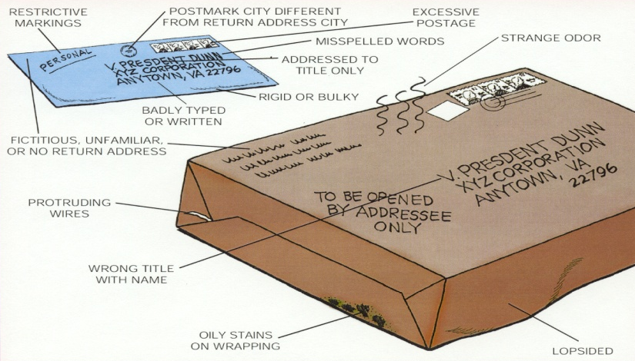
RECOGNIZING SUSPICIOUS MAIL
Excessive tape or sealing material
Lopsided or oddly shaped envelope
Oily stains on package
Mail has strange odor
Protruding wires
Powder or residue on envelope

Slide 8
RECOGNIZING SUSPICIOUS MAIL
The word “ANTHRAX” or “BOMB”
THIS ONE IS NOT VERY PROBABLE
Here is an example of what suspicious mail could look like…

Slide 9
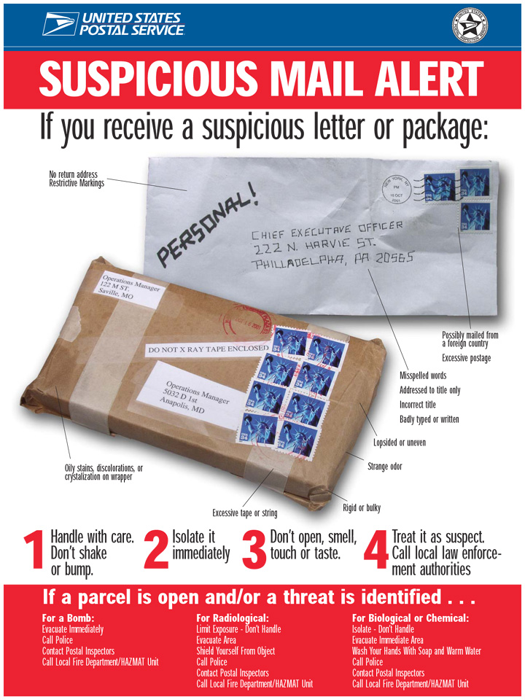
RECOGNIZING SUSPICIOUS MAIL

Slide 10
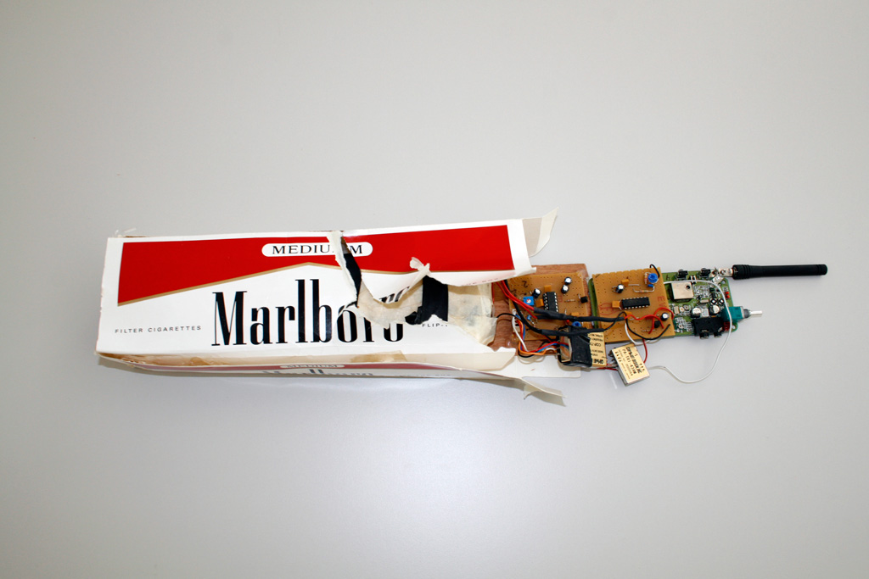
RECOGNIZING SUSPICIOUS MAIL

Slide 11
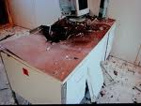
RECOGNIZING SUSPICIOUS MAIL

Slide 12
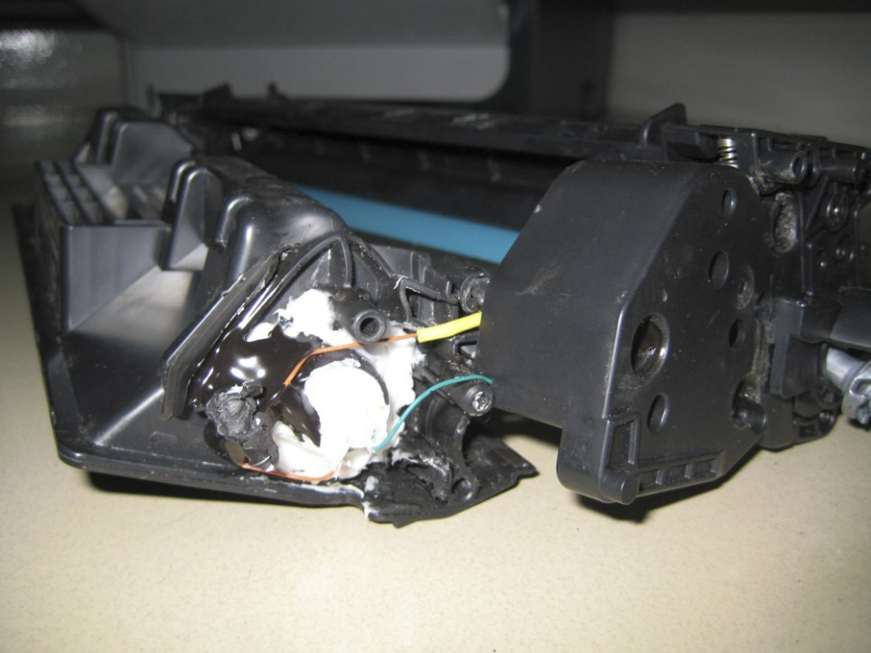
RECOGNIZING SUSPICIOUS MAIL

Slide 13
WHAT COULD BE IN THE MAIL?
Chemical or biological agents
Explosive devices

Slide 14
CHEMICAL/BIOLOGICAL AGENTS
A variety of either chemical or biological agents could be sent through the mail.
The biological agent most known is
"ANTHRAX"

Slide 15
ANTHRAX
ANTHRAX would normally appear as a white powder when transmitted via the mail.
ANTHRAX powder would normally be inside the mail piece, but residue could be on the outside of the envelope.

Slide 16
ANTHRAX
ANTHRAX IN POWDER FORM CAN BE SPREAD VERY RAPIDLY. IT CAN BE DISTRIBUTED THROUGH THE BUILDINGS’ CENTRAL HEATING AND AIR CONDITIONING SYSTEMS.

Slide 17
EXPLOSIVE DEVICES
Many varieties of explosive devices can be sent via mail, from letters to large packages may contain bombs.
The likelihood of you ever receiving a bomb in the mail is remote. Unfortunately, however, a small number of explosive devices have been mailed over the years resulting in death, injury and destruction of property.
NOTE: MOST MAIL BOMBS DO NOT TICK.

Slide 18
If you feel that you have received a piece of mail that is suspicious, here are some steps to follow:
STAY CALM

Slide 19
IF THE MAIL HAS NOT BEEN OPENED…
Isolate the mail piece if possible, but do not handle.
If you have detected a substance on the mail, or if it appears something has spilled from the mail, do not handle the mail further.
Notify others in the immediate area and stay away from the mail piece.
Notify your supervisor or manager.

Slide 20
IF THE MAIL HAS NOT BEEN OPENED…
Evacuate the room/area – Do not allow personnel to leave the facility.
Report incident to Base Security/Fire Department.
Be prepared to provide a list of personnel involved.

Slide 21
OTHER THINGS YOU MAY DO…
Wash hands with soap and cool water.
Turn off fans and portable heaters.
Turn off room or building ventilation system.
Do not remove anything from the room.
COOL WATER

Slide 22
IF YOU ARE OPENING OR HAVE AN OPEN PIECE OF MAIL…
If you detect a powder, some substance, a wire, or something metallic:
Put the mail piece down gently.
Notify everyone in the room, and leave slowly.
Notify your supervisor.
Call Base Security/Fire Department immediately.

Slide 23
WHAT IS BEING DONE BY USPS?
Minimal visual inspection only. Mail is not being x-rayed.
First class mail for Government agencies in Washington, D.C. is being irradiated. It is not being done in any other area.
Future Plans -- Many processes are being examined:
NONE APPROVED

Slide 24
WHAT IS BEING DONE BY
FLCN SMD NDW POSTAL DIVISION?
Constant visual inspection of all mail prior to delivery.
All suspicious mail is examined closely before it is delivered or disposed of.
SAFETY FIRST

Slide 25
CAN ANTHRAX OR OTHER AGENTS BE DETECTED PRIOR TO DELIVERY?
THE ANSWER IS BOTH YES AND NO
The Office of Science and Technology Policy notification states all government agencies to halt the purchase of any equipment offered for the detection of Anthrax. Their testing of all new devices proved to be only:
2% ACCURATE
The Navy at this time IS pursuing new avenues aimed at detection of chemical/biological agents, either in or on the mail.

Slide 26
WHAT CAN BE DONE?
Take every reasonable measure to assure the safety of employees and customers and keep the mail secure and under control.
Advise employees to maintain prudent, safe working methods. Respirators and gloves should be available to all employees who request them.
The best defense is having educated employees and knowledgeable citizens, mobilizing their common sense.
Restrict incoming personal mail to those members authorized to receive mail.

Slide 27
WHAT CAN BE DONE?
Return unsolicited advertising, bulk rate, catalogs and other non-first class mail to sender requesting removal from mailing list.
Require outgoing personal mail be deposited at U.S. Post Office by the originator.
Do not accept mail from unknown persons.
Keep to a minimum the number of people handling incoming mail until processed or delivered.

Slide 28
OSHA AND CDC RECOMMENDED
PROTECTIVE EQUIPMENT
Respirators:
3M N95 Particulate Respirator
Grainger Stock Number – 4HC73
Life expectancy: One full day
*Any use of this respirator requires coordination with installation safety office and enrollment in the Respirator Management Program

Slide 29

OSHA & CDC RECOMMENDED
PROTECTIVE EQUIPMENT
Protective Gloves:
Conney Nitrile Gloves: Disposable/4mm/9.5”
Grainger Stock Number – 3AH09
Life expectancy: One time use only

Slide 30
INSTALLATION EMERGENCY REPORTING NUMBERS
INSTALLATION | EMERGENCY# | NON-EMERGENCY#
NAS Patuxent River | 911 | 301-342-3911
Webster Field St Inigoes | 911 | 301-342-3911
NSA South Potomac Dahlgren | 540-653-8217 | 540-653-8095/8291
NSA South Potomac Indian Head | 301-744-4333 | 301-744-4370
Phila Naval Business Center | 215-897-8900 | 215-897-3333
NSF Carderock | 301-227-0000 | 301-227-1502
Joint Base Anacostia Bolling | 202-767-5000 | 202-433-3333
Washington Navy Yard | 202-433-3333 | 202-433-3333

Slide 31
VISIT THESE WEBSITES FOR MORE INFORMATION
www.usps.com
www.gsa.gov
www.osha.gov
www.navsup.navy.mil
www.cdc.gov
www.usps.com/postalinspectors
www.nor.fisc.navy.mil
www.anthrax.osd.mil
www.usamriid.army.mil

Slide 32
SAFETY FIRST
FOR YOUR CO-WORKERS, YOUR FRIENDS YOUR FAMILY PLEASE BE DILIGENT WHEN SCANNING, SORTING OR HANDLING MAIL.
PLEASE LET US GET HOME EVERYDAY.
IF IT LOOKS OUT OF PLACE, DIFFERENT, JUST NOT RIGHT, STAY CALM AND ISOLATE THE ITEM AND GET EVERYONE EVACUATED.

Slide 33
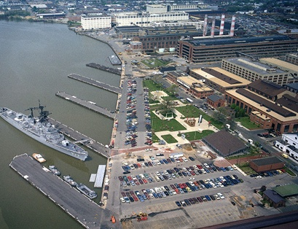
Contacts
Mr. David J. Smart
Director of Postal Operations, DON-NCR
Tel: 202-685-0901 DSN: 325-0901
David.j.smart2@navy.mil
Mr. Stanley McCaskill
Supervisory Postal Operations Specialist, DON-NCR
Tel: 202-685-0902 DSN: 325-0902
stanley.mccaskill1@navy.mil

